Slide 1

Applied Accounting Programs
Presenter: Prof. Ron Woods
Accounting Department Chair
Program Name
Goes Here
Presenter Name Goes Here
Notes:
Welcome, introduce yourself and the program. Feel free to share about your education/career background, how long you’ve been teaching, etc.

Slide 2
What is the program?
Short Description
The applied programs and degrees primarily provides students with the training for a career in accounting in one of accounting’s many related career pathways.
AAS - AAS Associate of Applied Science Degree
CERTIFICATES –Accounting Achievement, Tax Preparer, Non-Profit Management.
These degrees, education and training are all intended to prepare students to go right to work in the appropriately trained area of accounting.
Where is this program offered?
North Seattle College
9600 College Way N
Seattle, WA 98103
Entry Requirements
High School Diploma/GED
Running Start or other similar
high school/college programs

Slide 3
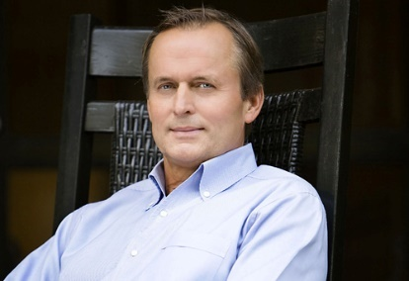

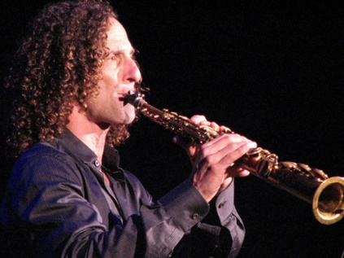



Quiz Time
Which of the following notable people either worked in accounting or majored in accounting?
John Grisham - bestselling author of such classics as The Firm and The Pelican A | Select the single best answer from the options below. | Janet Jackson – sister of the King of Pop, Michael Jackson, platinum record and five Grammys holder singer, and entertainer. B
Kenneth Bruce Gorelick, better known as Kenny G, - world-famous saxophonist and top-selling instrumental musician in modern history. C | . A & F A, F & C E, F & B A, F & D All of them | Legendary Rolling Stones front-man Mick Jagger D
Phil Knight – Philanthropist, business magnate, and co-founder of Nike, Inc. E |  | Ron Woods – Faculty Chair and distinguished professor of accounting, North Seattle College. F

Slide 4
What do you learn?
Below are among the many tasks that accountants perform for their clients.
Organizing and maintaining financial records
Evaluating financial operations and making recommendations to management about best financial practices
Examining account books and accounting systems to make sure they are efficient and conform to accepted standards and accounting procedures
Preparing tax returns and related tasks
Examining financial statements to make sure they are accurate and meet legal requirements
suggesting ways to increase revenue, reduce costs, and improve profits
If we go back to the question of what accounting students learn in our programs – They essentially learn the skills to do the above.

Slide 5
Education Pathway
The Programs Presented in This Applied Accounting Break-out Session
Are designed to be completed from two academic quarters, to two academic years if you are participating as a full-time student taking three courses per quarter. An academic quarter is approximately 11-wweeks on average.
The length for any one part-time student might take to complete a given program varies with each part-time student, depending on the program selected and their personal schedule.
While it is preferably for students to complete their program study as quickly as possible and in accordance with the respective program schedule, there are no requirements to do so. Student can start, stop, and resume program study to meet employment and personal needs.
The nature of accounting courses and learning objectives require certain courses be completed before others. Consult with your advisor before deciding to pause your study or skip a quarter.
Designed to be part of a longer education pathway? They a start with certificates that are stackable and generally connects to an associate’s degree and BAS degree pathway.
Many of the certificates qualify students to get employment right away. Still, more education is typically needed to start work in some fields.

Slide 6
There are Basically Four Types of Accounting
Corporate Accounting | Public Accounting | Government Accounting | Forensic Accounting
Corporate accounting involves the use, handling, and filing of a company’s financial data often for the purpose of external reporting and tax compliance. | Public accountants work with external clients, most often companies, corporations, or individuals. Their responsibility to clients is to help ensure their financial statements, records, and filings are accurate. | Government accountants work within the context of local, state, or federal government entities. They often work within frameworks that differ from those employed by public accountants. | Forensic accounting refers to a branch of accounting that collects, recovers, and reconstructs financial data when it is difficult or impossible to obtain.
Generally, Requires The Following:
4-year degree in accounting or higher. *CPA preferred but not required. Some experience preferred. *experience required before CPA license can be issued. | 4-year degree in accounting or higher. CPA required. Experience required. | 4-year degree in accounting or higher. CPA preferred but not required. Some experience preferred. | 4-year degree in accounting or higher. CPA preferred but not required. Some experience preferred

Slide 7
Careers in Accounting
Government and Non-Profit Accounting Jobs: Fund Accountancy IRS Jobs | Private Accounting Jobs: Accounting Clerk Accounts Payable/Receivable Clerk Bookkeeping Budget Analyst Comptroller/Financial Controller Payroll Accountant
Public Accounting Jobs: Cost Estimator Enrolled Agent Forensic Accountant Real Estate Appraiser Tax Accountant Tax Attorney Tax Preparer | Financial Services: Business Valuation Specialist Certified Financial Planner Financial Analyst Tax Consultant

Slide 8

What you can you earn with skills and/or a degree in Accounting?
There are several internship or work-based learning programs offered.
Program graduates typically work across the full spectrum; private business, government, and not-for-profit industries.
Average wages for local area entry level to experienced varies. However, you can expect to earn from $39,000 to $48,000 after completing a certificate and/or 2-year accounting degree. If you complete a Bachelor's degree, you can expect to start on average, at a salary of around $61,513.

Slide 9

NOTE: Salary ranges can vary widely depending on many important factors, including education, certifications, additional skills, the number of years you have spent in your profession. For more detailed information and planning, visit the following site: https://seakingwdc.emsicc.com/?radius=5%20miles&region=Seattle%2C%20WA
Salary Ranges for Entry Level Accountants in Seattle, WA is: From $61,513 to $96,263, with a median salary of $94,771. The middle 67% of Entry Level Accountants makes $75,275, with the top 67% making $76,460.
Salary Ranges for Bookkeepers is: Between $42,573 and $54,416. The average in Seattle as of March was $48,509.
Salary Ranges for Tax Preparers in Seattle, WA: Entry level of $65,945 and a senior level of $115,404.
Salary Ranges for Financial Services Jobs in Seattle, WA is: Between $39,000 at entry and $58,000 at the median. Note: Jobs in this area vary greatly and includes fields such as banking, financial planning, property management, etc. Workers in this industry often earn considerably more than the median.

Slide 10
Q & A
If you have any questions about a typical studying accounting at NSC such as:
What is a typical accounting course workload and schedule?
Do students often balance work with school?
What type of faculty are teaching in this program?
My contact information is listed below.
If you have questions about college admissions, advising, etc., I encourage you to stick around for help from 4:30-5pm.
Contact:
Program Coordinator
Ron Woods
ronald.woods@seattlecolleges.edu
Workforce Instruction Division

Slide 11

Return to Main Session
(select “Leave Breakout Room” to return)

